Slide 1
CPE 656
Software Engineering Studio I
Train Location Project
University of Alabama in Huntsville
October 5, 2015
Stephen Jalbert
Rashad Madyun
Corey Sanders

Slide 2
WORK PRODUCTS
ROM: Complete
SRS: System Requirements available for Review. Formatted into template according to IEEE 830 standard.
Hardware Selection: Recommended Hardware Available for Review
Process Document: In Review
Configuration Management Document: In Review

Slide 3
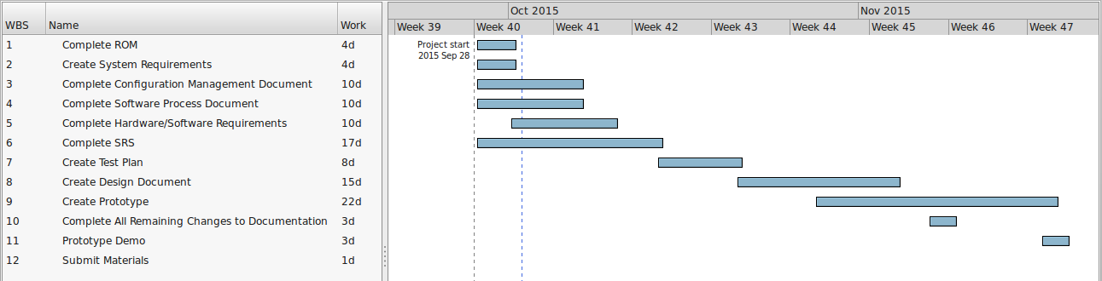
Schedule

